Slide 1
STOCK DATA MONITORING

Slide 2
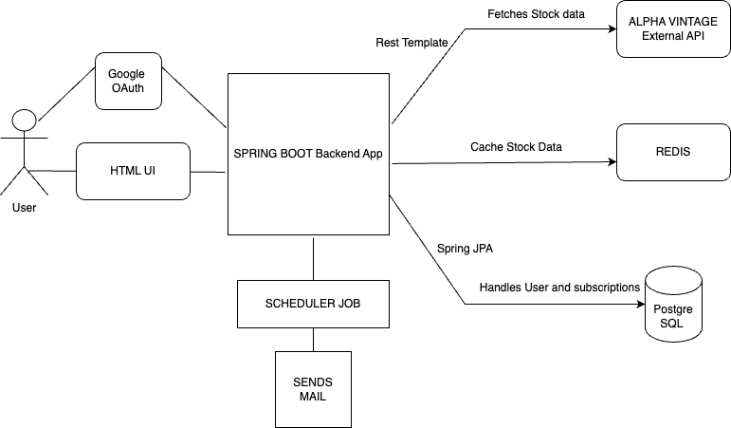
Architecture Diagram

Slide 3
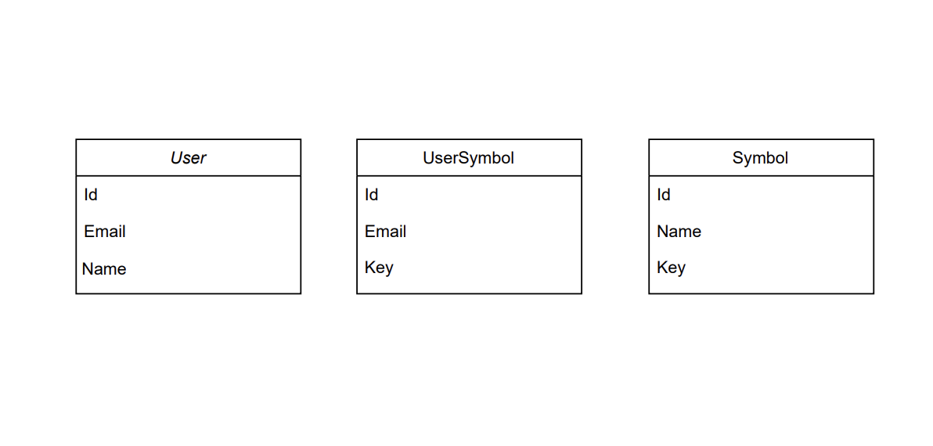
DB Design

